Slide 1
Kernel memory allocation
Unix divides memory into fixed size pages
Page size is a power of two – typical size is 4kbytes
Because Unix is a VM system, logically contiguous pages need not to be physically adjacent
Memory management subsystem maintains mapping between the logical pages and physical frames

Slide 2
Memory allocators in the kernel
Page-level allocator – - paging system - - user processes - - block buffer cache, - kernel memory allocator - - network buffers - - proc structures - - inodes, - - file descriptors

Slide 3
Functional requirements
Kernel allocator services requests for dynamic memory allocation for its clients not for user processes
Must use the allocated space efficiently – allocation may be fixed or not, it may be possible to exchange it with paging system
If it runs out of memory it blocks the caller, until more memory is free
Must monitor which parts of its pool are allocated and which are free

Slide 4
Evaluation criteria
Efficiency - utilization factor - ratio of total memory requested to that required to satisfy the requests
Speed – average and worst case latency
Simple programming interface suitable for a wide variety of clients
Allocated memory should be properly aligned for faster access – minimum allocation size
Handle requests of different sizes
Interact with the paging system for exchange of memory space

Slide 5
The buddy system
Combines free buffer coalescing with a-power-of-two allocator
Creates small buffers by repeatedly halving a large buffer and coalescing adjacent free buffer
Each half of a split buffer is called a buddy
Advantages – flexible – allows to use buffers of different sizes, easy exchange of memory between the allocator and the paging system
Disadvantage - poor performance, inconvenient programming interface, impossible to release a part of a buffer

Slide 6
SVR4 lazy buddy algorithm
Coalescing delay – time taken to coalesce a single buffer with its buddy.
To avoid coalescing delay we can defer coalescing until it becomes necessary, and then coalesces as many buffers as possible.
It improves the average time for allocation and release, but results in slow response for requests invoking coalescing routine.
SVR4 offers an intermediate solution which is more efficient.

Slide 7
SVR4 lazy buddy algorithm
Buffer release involves two steps. First the buffer is put on the free list. Second, the buffer is marked as free in the bitmap and coalesced with adjacent buffers if possible.
The lazy buddy system always performs the first step. Whether it performs the second step it depends on the state of the buffer class.
A buffer class can be in one of three states : lazy – coalescing is not necessary, reclaiming – coalescing is needed, accelerated – allocator must coalesce faster

Slide 8
SVR4 lazy buddy algorithm
State of the buffer is determined by the slack:
slack = N – 2L – G where
N number of buffers in the class, L – numbers of locally free buffers, G – numbers of globally free buffers,
System is in: lazy state when slack >= 2
reclaiming state when slack = 1
accelerated state when slack = 0

Slide 9
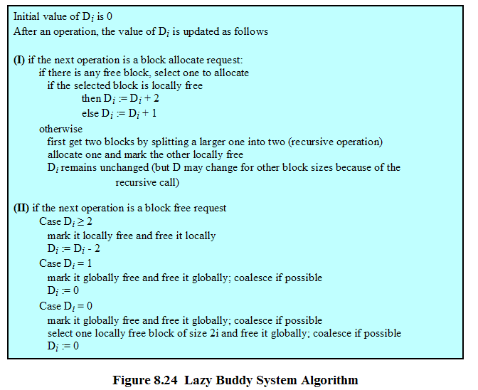
SVR4 lazy buddy algorithm

Slide 10
Solaris 2.4 Slab allocator
Design issues
Object reuse
Hardware cash utilization
Allocator footprint

Slide 11
Object reuse
Allocate memory
Construct (initialize object)
Use the object
Deconstruct it
Free the memory

Slide 12
Hardware cash utilization
When the hardware references an address, it first checks the cache location to see if the data is in the cache. If it is not, the hardware fetches the data from main memory into the cache, overwriting the previous contents of the cache location.

Slide 13
Allocator footprint
It is the portion of the hardware cache and the Translation Lookaside Buffer that is overwritten by the allocation itself.
The slab allocator has a small footprint, since it determines the correct pool of buffers by a simple computation and merely removes a buffer from the appropriate free list.

Slide 14
Linux Memory Management
Page directory
Page middle directory
Page table

Slide 15
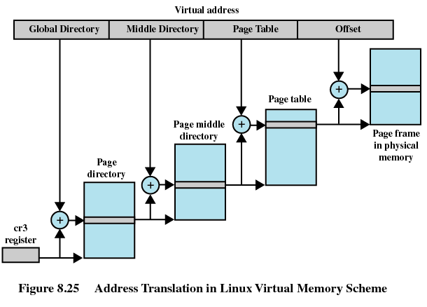

Slide 16
Page allocation
Buddy system is used
Kernel maintains a list of contiguous page frame groups of fixed size (e.g. 1, 2, 4, ..32 page frames)
As pages are allocated and deallocated in main memory, the available groups are split and merged

Slide 17
Page replacement algorithm
Based on the clock algorithm
The use bit is replaced with an 8-bit age variable
Each time that a page is accessed, the age variable is incremented
A page with an ago of 0 is best candidate for replacement
The larger the value of age of the page, the least it is eligible for replacement
It is a version of least frequently used policy.

Slide 18
Kernel memory allocation
Page allocation for kernel uses the same scheme as for user virtual memory management
buddy algorithm is used so that kernel can be allocated in units of one or more pages
To allocate chunks smaller than a page Linux uses slab allocation
The chunks can be 32 to 4080 bytes
Chunks are on a linked list, one for each size of a chunk
Chunks may be split and aggregated and moved between lists

